Slide 1
Coordination Committee 2012-2015
1st meetings of WOC
PGC & TF
Autumn 2012
Introduction to TWP

Slide 2
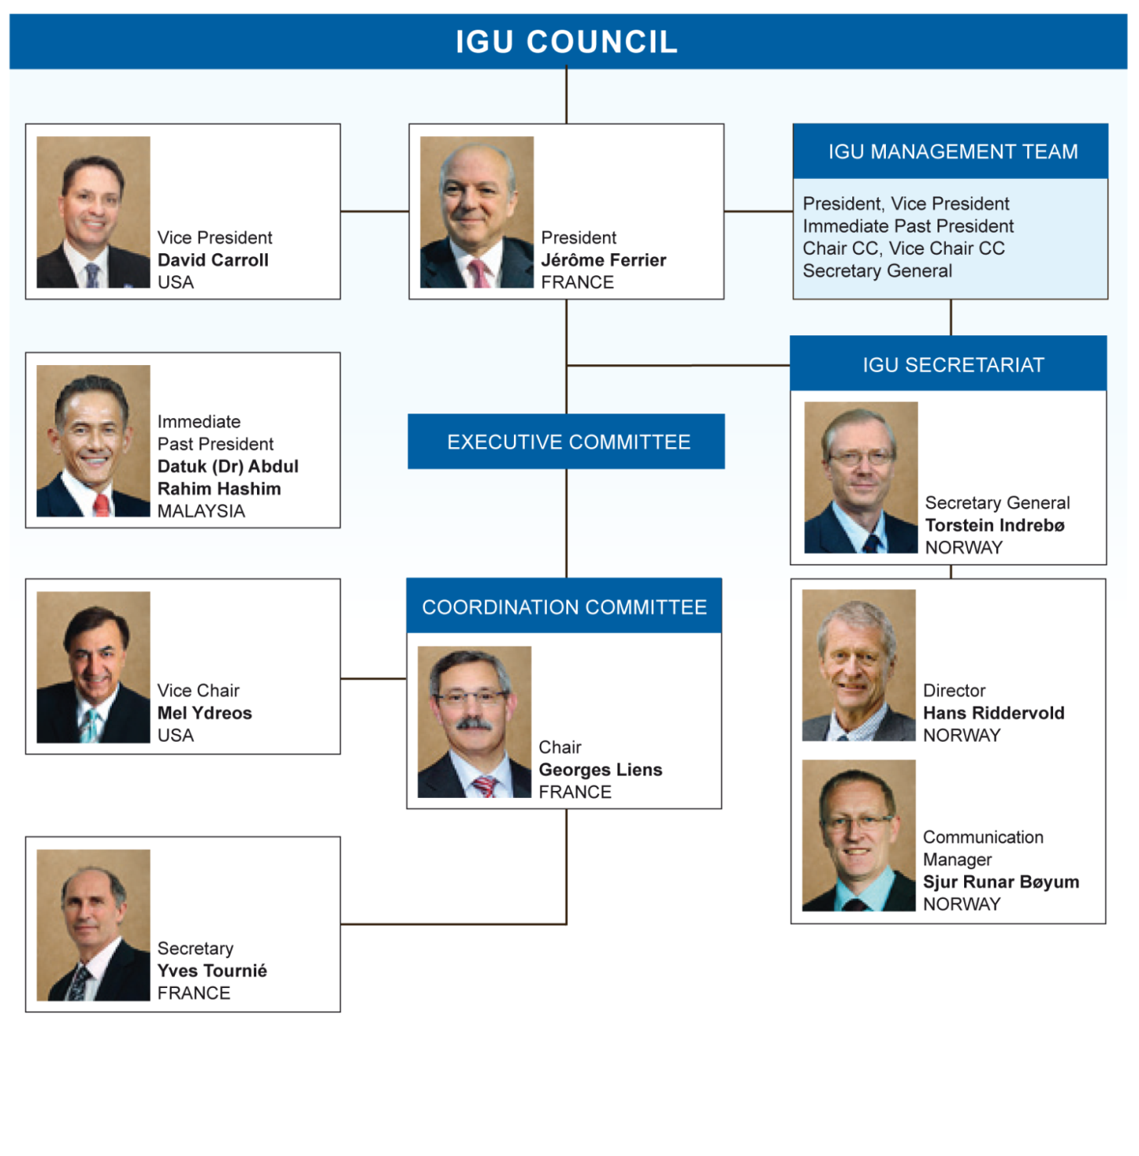
2012 – 2015 Key Authorities

Slide 3
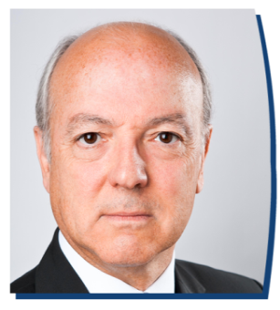
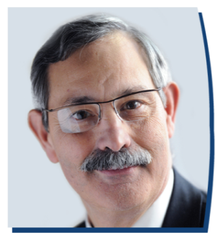

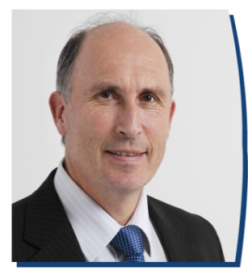
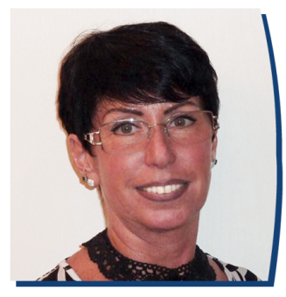
Introduction to the French Team
Jérôme Ferrier
President IGU
Georges Liens
Chairman
Coordination Committee
Daniel Paccoud
Chairman
National Organising Committee
Yves Tournié
Secretary
Coordination Committee
Annie Louys
Secretary
National Organising Committee
EXHIBITION
CONFERENCE
SERVICES

Slide 4

Triennium Theme
“ Growing together towards a friendly planet ”
Natural Gas is a “foundation” fuel, core pillar for a Sustainable Development
Natural Gas must be available everywhere (new emerging
countries) and its role will grow in Asia and South America...
Continuity is key. We must build on the work carried out during the previous triennia

Slide 5
Strategic guidelines: main headlines
“ Growing together towards a friendly planet ”
Advocating for the development of natural gas as a
foundation fuel for Sustainable Development
Promoting an accurate combination with renewables
& electricity
Improving the availability of natural gas in new areas & in
developing countries
Attracting and retaining Human Resources for the
Future

Slide 6

Strategic vision 2012 – 2015
The 4 pillars
“Growing together towards a friendly planet”

Slide 7

2012 – 2015 Strategic vision for Paris
“Growing together towards a friendly planet”

Slide 8
Committee Structure 2012-2015
COORDINATION COMMITTEE CHAIRMAN
SECRETARY
VICE CHAIRMAN
WOC 1
E&P
WOC 2
Storage
WOC 3
Transmission
WOC 4
Distribution
WOC 5
Gas use
GAS CHAIN
PGC A
Sustainability
PGC B
Strategy
PGC C
Gas Markets
PGC D
LNG
PGC E
Marketing & Com
PGC F
R D & I
TF1
Human Capital
TF2
Gas Advocacy
TF3
Geopolitics

Slide 9



























IGU Committee and TF Chairs
CHAIRS
Vice CHAIRS
from
WOC 1
BRAZIL
DENIS DINELLI
WOC 2
SLOVAKIA
LADISLAV GORYL
WOC 3
ARGENTINA
BENJAMIN GUZMAN
WOC 4
GERMANY
DIETMAR SPOHN
WOC 5
RUSSIA
EUGENE PRONIN
PGC A
JAPAN
SATHOSHI YOSHIDA
PGC B
ALGERIA
FETHI ARABI
PGC C
KOREA
GI CHUL JUNG
PGC D
THE NETHERLANDS
DIRK VAN SLOOTEN
PGC E
SPAIN
ALFREDO INGELMO
PGC F
USA
JACK LEWNARD
TF 1
HUMAN CAPITAL
AGNES GRIMONT
TF 2
GAS ADVOCACY
MICHELE PIZZOLATO
TF 3
GEOPOLITICS
GEERT GREVING

Slide 10
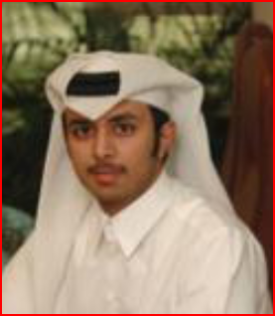
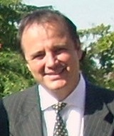
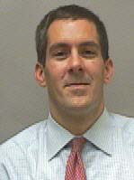
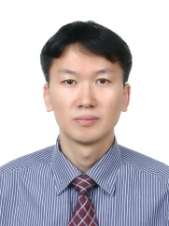
Task Forces
HUMAN CAPITAL
This TF will continue to build on the excellent results already obtained by TF1 and TF2 under the Malaysian Presidency.
This Presidency will propose transforming this TF into a PGC during the next triennium
GAS ADVOCACY
This high level TF will continue to actively lobby for gas advocacy, with assistance from WOC, PGC Chairs and the Secretariat in line with regional associations and coordinators
GEOPOLITICS
The objective of this TF is to organise workshops to facilitate exchanges between political and industrial decision-makers on a regional level

Slide 11
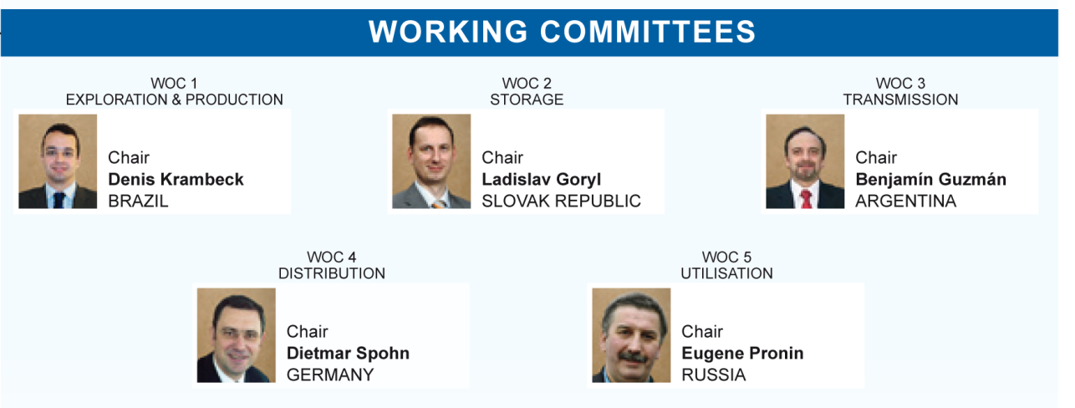
WOC

Slide 12
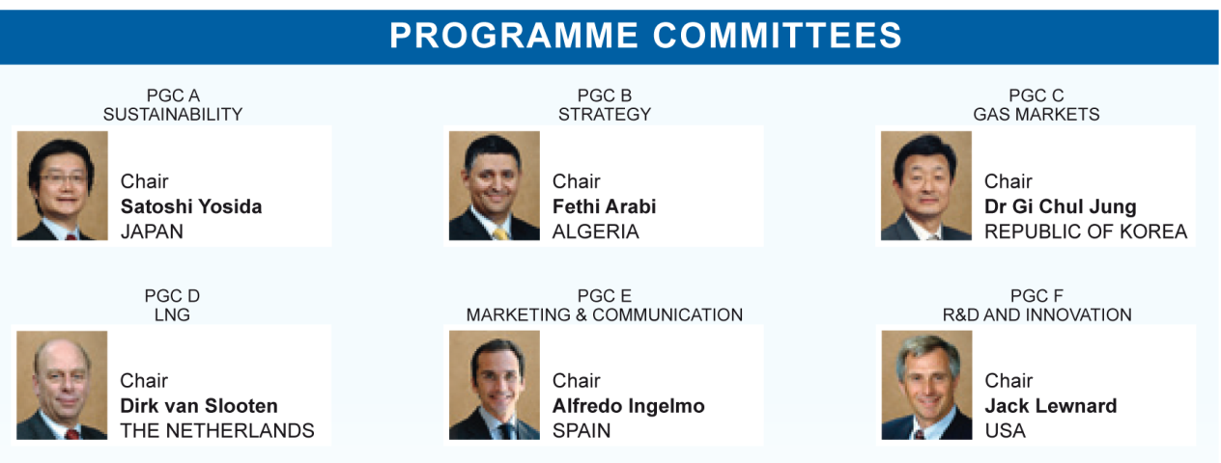
PGC

Slide 13
New issues and continuity : special reports
“Growing together towards a friendly planet”
2050 natural gas prospective coordinated by PGC B
Natural gas, a key factor for sustainable development in emerging
countries (PGC C)
i-gas industry (PGC E)
Efficiency and convergence with renewables and electricity
(PGC F)
Best practices (all committees)
Human Capital a transversal approach from all committees
led by TF1

Slide 14
Suggested Transversal Issues
“Growing together towards a friendly planet”
A representative from each WOC will participate in TF1 (HR)
largely open
A representative from each WOC + PGC A & D will participate in
PGC F (RD&I)
A representative from each WOC will participate in PGC A (SD)
TF2 (Gas Advocacy): open to all CC members, participation of at least one Authority from PGC E, A, B and WOC 5, + regional coordinators + Secretariat + some experts, in charge to maintain and improve the “Natural Gas : Facts & Figures” with PGC E

Slide 15
Strategic vision 2012 – 2015
The 4 pillars
“Growing together towards a friendly planet”
TF 1
PGC A
PGC F
PGC C
You can download the complete TWP :
http://www.wgc2015.org/le-triennium/le-triennium-francais/

Slide 16

The 4 pillars : transversality
PGC A, B, C, D, E & F,
WOC 1, 2, 3, 4 & 5 / TF 1 & 2
PGC F, A, B & E,
WOC 2, 4 & 5 / TF 1 & 2
PGC C, A, B, D & E,
WOC 1, 3 & 5 / TF 2 & 3
TF 1, PGC A, E & F,
WOC 1, 2, 3, 4 & 5

Slide 17
Membership participation
 | Nbr of nominees | From countries
On 11/09/2012 | 646 | 41
Top 5 participant countries | Nominees | To Groups
France | 70 | 14
Algeria | 42 | 13
Iran | 42 | 14
Brazil | 39 | 14
Poland | 35 | 13
 | Nbr of nominees
WOC 1 | 50
WOC 2 | 35
WOC 3 | 70
WOC 4 | 66
WOC 5 | 62
PGC A | 45
PGC B | 72
PGC C | 45
PGC D | 64
PGC E | 46
PGC F | 33
TF 1 | 20
TF 2 | 16
TF 3 | 22
You can continue to nominate people and to reinforce the expertise of our groups :
ytournie@wgc2015.org

Slide 18
Key milestones special reports
Special reports of the triennium
Title | Responsibility | Date of completion
2050 natural gas prospective | PGC B | March 2015
Natural gas, a key factor for sustainable development in emerging countries | PGC C + TF3 | March 2015
i-gas industry | PGC E | March 2015
Global LNG Report | PGC D | Yearly in May
Efficiency and convergence with renewables and electricity | PGC F | March 2015
Best practices | All + compil. by CC | March 2015
Human Capital transversal approach | TF1 + all | March 2015

Slide 19
Key milestones : papers submission
Year | Date | Milestone/Venue | Event
2014 | 1st February | Call for papers | Issuing call for papers
 | July | Call for papers | reminder
 | 1st September | Call for papers | Abstract submission
 | 1st November | Call for papers | Final selection by Committees
 | 15 November | Call for papers | Author notification
2015 | 1st February | Call for papers | Full paper submission
 | 1-5 June | Paris | 26th World Gas Conference

Slide 20
Dates and venues of the Triennium
CC meetings + Pillar’s Workshops
Working Groups meetings each semester
Date
Venues
Workshops
16-19 October 2012
Ottawa , Canada
Yellow Pillar (RENs)
9-11 April 2013
Sevilla, Spain
Purple Pillar (HR)
22-25 October 2013
Red Pillar (Markets)
Beijing, P.R. China
25-27 March 2014
Advocacy & Com.
Brisbane, Australia
14-17 October 2014
Green Pillar (SD)
Berlin, Germany
24-26 March 2015
Cairo, Egypt
1-5 June 2015
Paris, France

Slide 21
IGU WEBSITE
www.igu.org
Please connect on :
http://www.igu.org/login_form?came_from=http%3A//www.igu.org/committees/pgc/b/col&retry=&disable_cookie_login__=1
Login : Gas4ever
Password : 2015FR
You can consult the documentation already published
The secretaries must verify and update the presentation of their WG (they have their own access rigths)

Slide 22
French Triennium 2012 – 2015
WEBSITE
www.wgc2015.org
WGC 2015’s website is now available
It features :
    Info on the French Triennium
    The Triennial Work Program
    A presentation of the host nation
    Real time information on gas industry

Slide 23
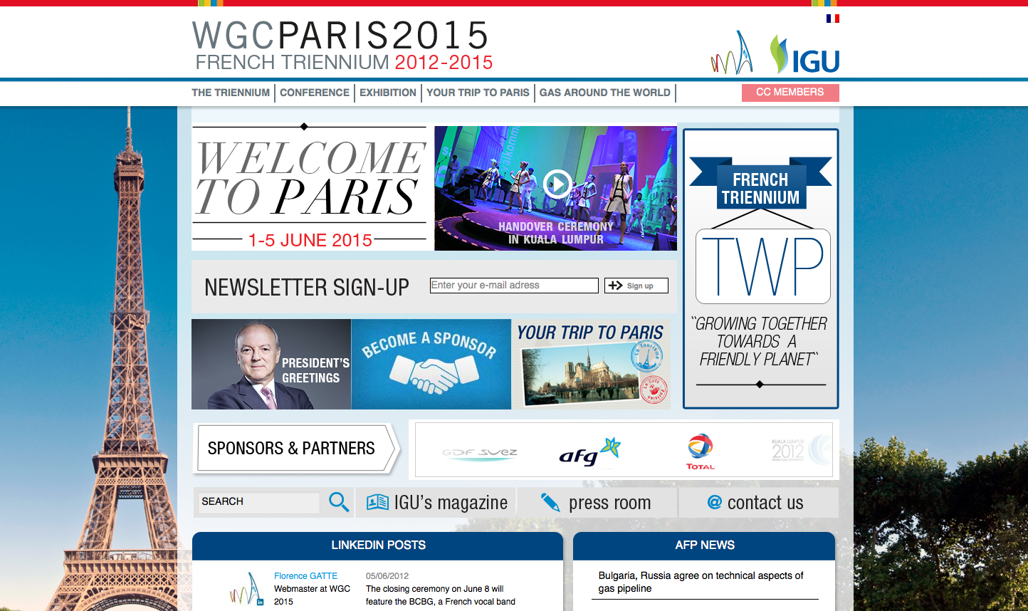
French Triennium 2012 – 2015
WEBSITE

Slide 24
French Triennium 2012 – 2015
EXTRANET
members.wgc2015.org
Introducing IGU WGC 2015 Growing Together:
    A collaborative platform
    Showcases the work in progress
    Initiates and encourages exchanges in the Working Groups
    Stimulates interconnection between committees

Slide 25
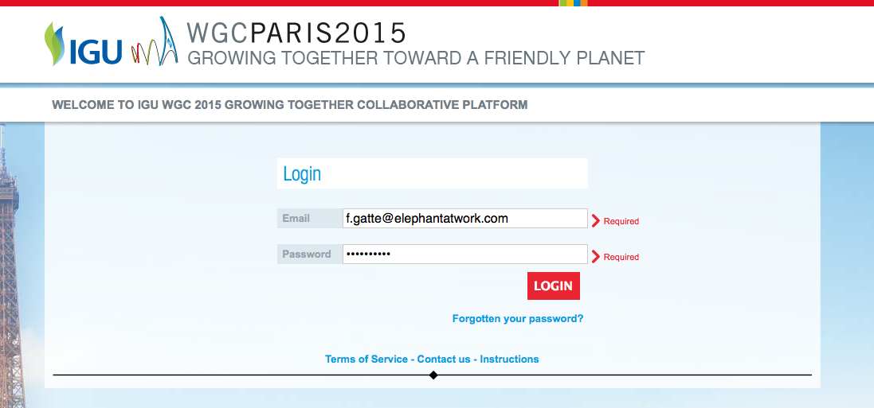
French Triennium 2012 – 2015
EXTRANET – connect & login

Slide 26
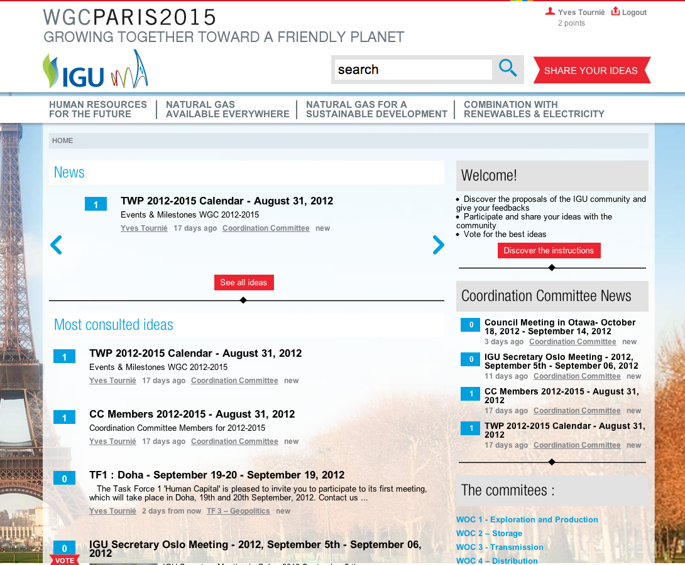
French Triennium 2012 – 2015
EXTRANET – see all member’s ideas

Slide 27
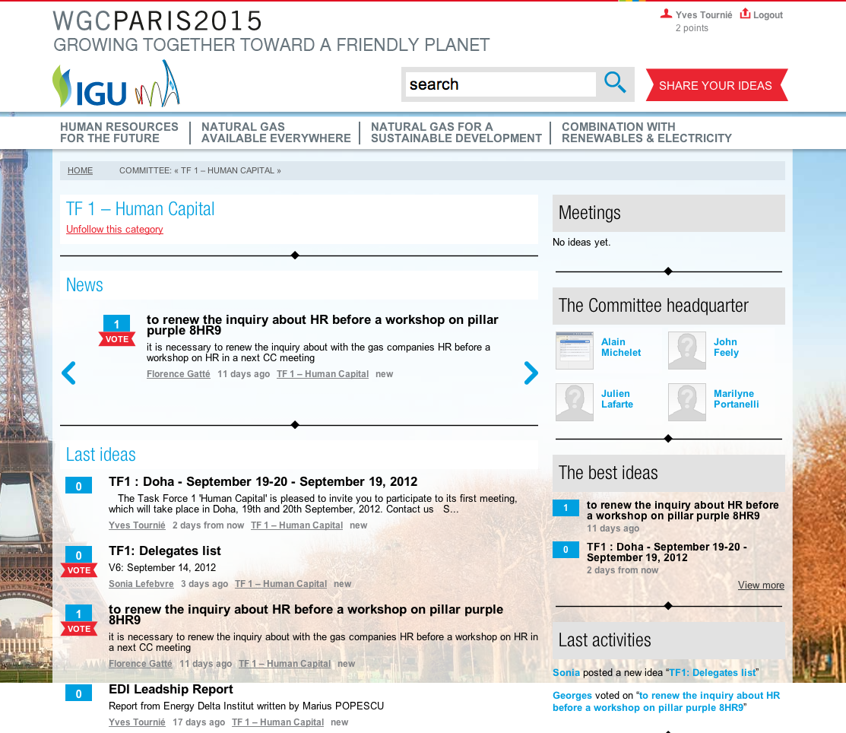
French Triennium 2012 – 2015
EXTRANET – see all TF 1 ideas

Slide 28
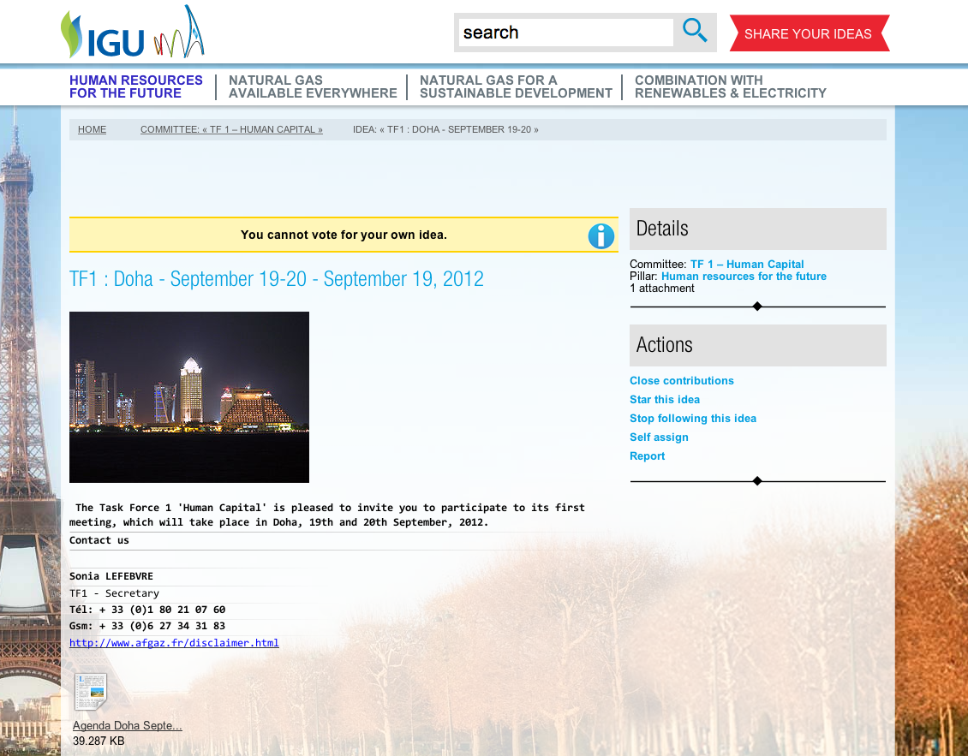
French Triennium 2012 – 2015
EXTRANET – see TF 1 Agenda

Slide 29
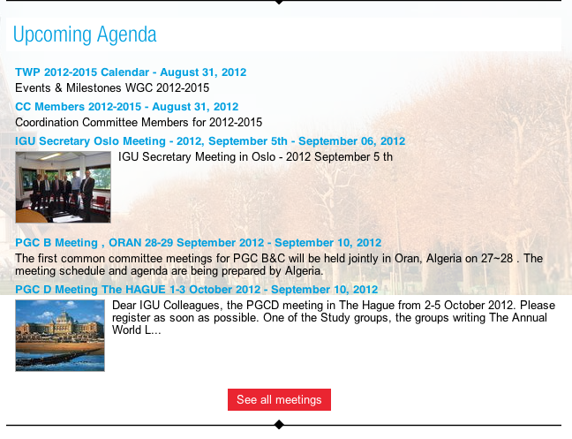
French Triennium 2012 – 2015
EXTRANET – see upcoming meetings

Slide 30
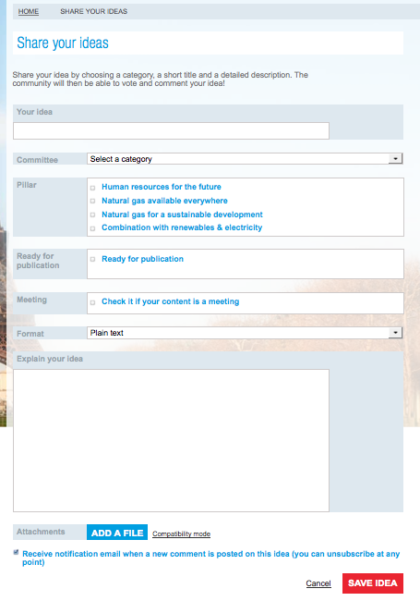
French Triennium 2012 – 2015
EXTRANET – share your ideas

Slide 31

French Triennium 2012 – 2015
EXTRANET – attach a document

Slide 32
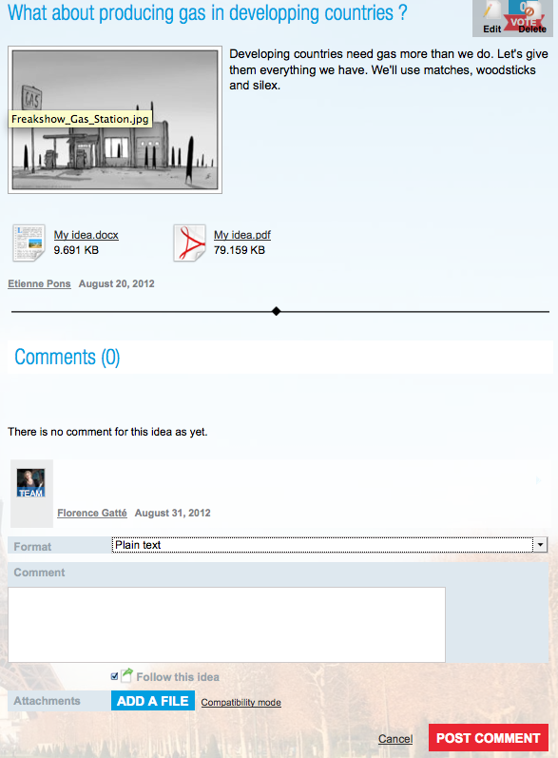
French Triennium 2012 – 2015
EXTRANET – comment an idea

Slide 33
French Triennium 2012 – 2015
EXTRANET – vote for an idea

Slide 34
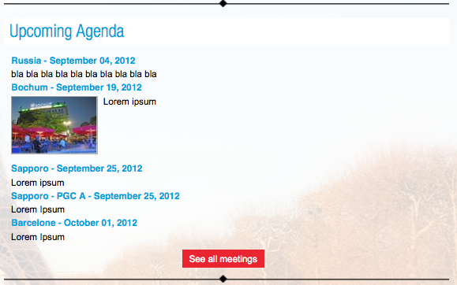
French Triennium 2012 – 2015
EXTRANET – see upcoming meetings

Slide 35
Coordination Committee 2012-2015
ytournie@wgc2015.org
gliens@wgc2015.org
TWP available on : http://www.wgc2015.org/le-triennium/le-triennium-francais/
Growing Together( Social TWP Network) available soon on:
http://ccmembers.wgc2015.org/
Thank you for your attention !

